Slide 1
Fetching Data
Call Fetch() | The Effect Hook | useEffect’s Dependency Array | Loading and Error Messages
Notes:
Welcome to our lecture on how to fetch data using fetch functions. In this lecture we will go through the call fetch function, Effect hook, use effect hook dependency array, and loading and error messages in react. Let’s start the video lecture.

Slide 2

Call Fetch()
React components can retrieve data using network requests, like weather forecasts from third-party APIs.
The fetch() method is commonly used for sending web API requests.
Axios, a third-party library, is another option for API requests but is not covered here.
Notes:
React components can retrieve data using network requests, like getting weather forecasts from third-party APIs. The fetch method is commonly used for sending web API requests. Axios, another popular library for API requests, offers more features but is not covered here. Fetch keeps applications dynamic by updating data without reloading the page.

Slide 3
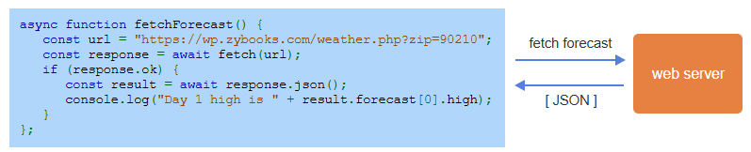
Example
Notes:
This example shows how to use the fetch method in React. The async function fetchForecast sends a request to a weather API. If the response is successful, the data is converted to JSON, and the forecast high for day one is displayed in the console. This demonstrates how fetch retrieves and handles data from web servers, keeping React applications dynamic and interactive.

Slide 4
The Effect Hook
Effect hook in React allows components to perform side effects like updating the DOM or fetching data.
It is implemented using useEffect() with a function argument.
By default, the function executes after every render of the component.
Notes:
Effect hook in React allows components to perform side effects like updating the DOM or fetching data. It is implemented using use Effect with a function argument. By default, the function executes after every render of the component. This makes it useful for tasks like data fetching, subscriptions, or manually changing the DOM outside of React's control.

Slide 5
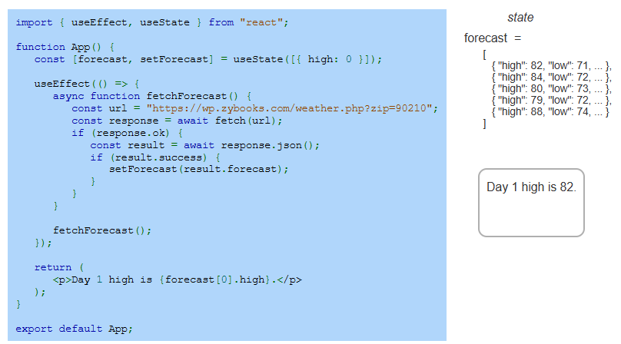
Example
Notes:
This example uses use Effect and use State to fetch weather data in React. Use Effect triggers fetch Forecast on component render. The data is fetched using fetch, and if successful, the forecast state is updated with set Forecast. The high temperature for day one is then displayed. This shows how use Effect manages side effects like data fetching in React.

Slide 6
useEffect's dependency array
useEffect() runs after every render unless given a dependency array listing variables that can change.
An empty array [] runs the effect only once after the first render.
In the example, the App component allows users to enter a ZIP code, updating the zip state variable.
useEffect() depends on zip, fetching weather data whenever zip changes, displaying a 5-day forecast.
Notes:
Use Effect runs after every render unless given a dependency array listing variables that can change. An empty array runs the effect only once on the first render. In the example, the App component updates the zip state variable. Use Effect depends on zip, fetching weather data whenever zip changes, displaying a 5-day forecast. This optimizes performance and reactivity.

Slide 7
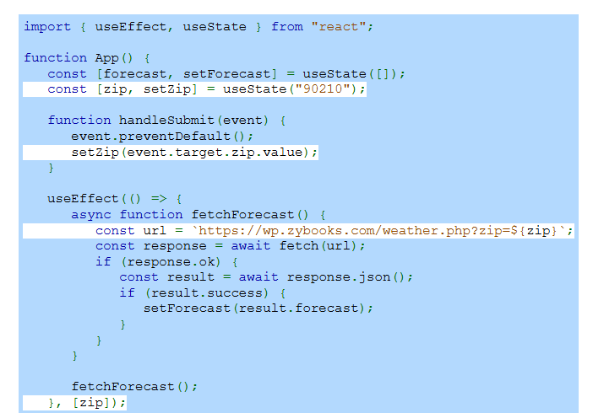
Example
Notes:
This example shows use Effect with a dependency array in React. The zip state changes when a user submits a ZIP code. Use Effect depends on zip, triggering fetch Forecast whenever zip updates. The updated forecast is then displayed. This approach efficiently fetches data only when needed, optimizing performance and making the component reactive to user input.

Slide 8
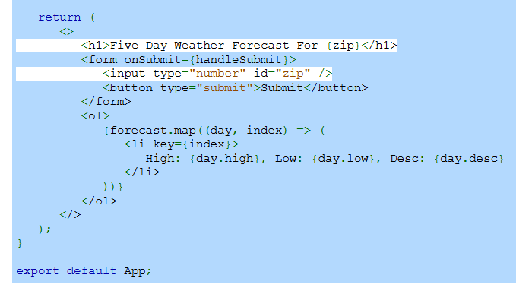
Example (Continue)
Notes:
This continuation of the example shows how the forecast data is displayed in React. The form takes a ZIP code as input, triggering handleSubmit to update zip state. The forecast array is mapped to list items showing high, low, and description for each day. This dynamic rendering keeps the UI updated, demonstrating how React efficiently manages state and displays fetched data.

Slide 9
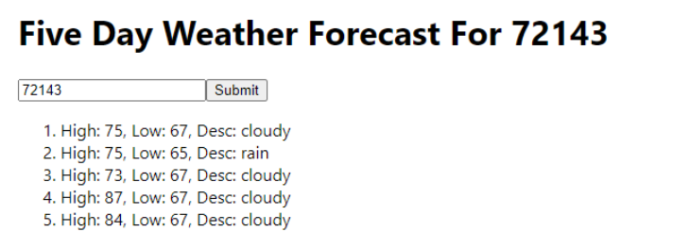
Example (Continue)
Notes:
This is the output of the weather forecast example in React. After entering a ZIP code and clicking Submit, the app displays a five-day forecast showing high, low, and description for each day. This demonstrates how use Effect and fetch work together to retrieve and display dynamic data, providing a responsive and interactive user experience.

Slide 10
Loading and error messages
Delayed responses or errors can occur with web API requests, so users need to be informed.
isLoading state shows a "Loading..." message while waiting for an API response, then displays the forecast.
errorMessage state shows an error message if set, or nothing if it's an empty string.
Notes:
Delayed responses or errors can occur with web API requests, so users need feedback. Is Loading state shows a Loading message while waiting for an API response, then displays the forecast. Error Message state shows an error if set or nothing if it's an empty string. This improves user experience by clearly indicating loading and error states.

Slide 11
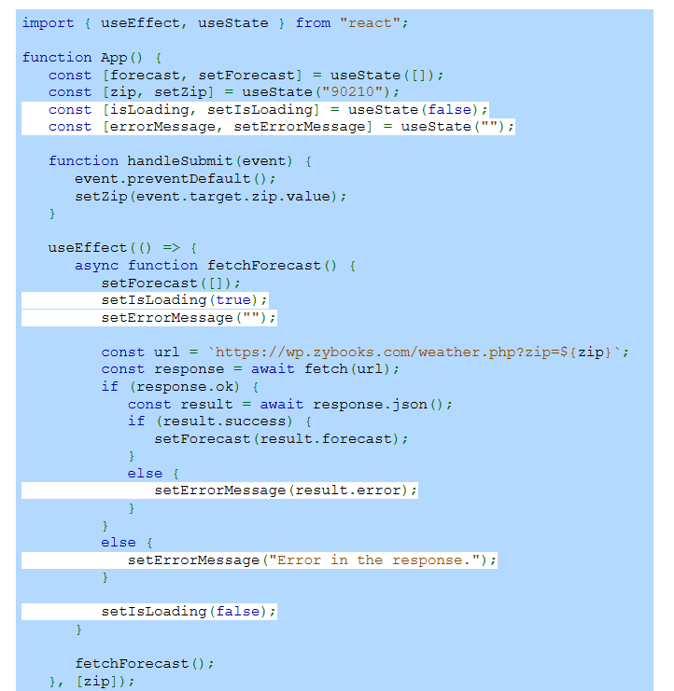
Example
Notes:
This example adds loading and error states to the React weather app. Is Loading is set to true before fetching data, showing a Loading message. If the fetch is successful, is Loading becomes false and the forecast displays. If an error occurs, error Message is set, showing an error message. This approach improves user experience by clearly handling loading and error states.

Slide 12
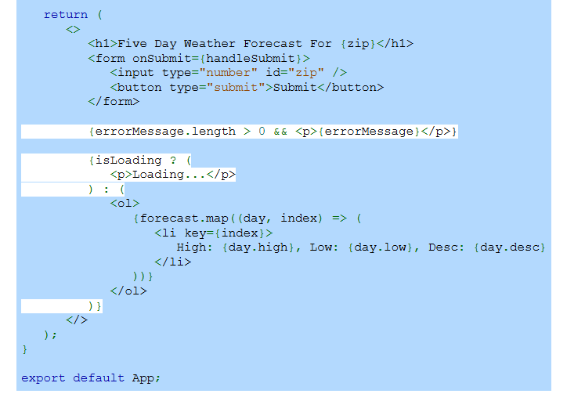
Example (Continue)
Notes:
This continuation shows how loading and error states are displayed. If error Message is not empty, the error message is shown. If is Loading is true, a Loading message appears. Otherwise, the forecast is mapped to a list of high, low, and description for each day. This approach keeps the user informed of loading or error states, enhancing the overall user experience.

